Slide 1
Computational Thinking
Core Concepts

Slide 2
What is Computational Thinking?
Computational thinking is a way of understanding complex problems in order to form a solution that can be implemented by either a computer, a human or a combination of both.
There are four key elements to computational thinking:
Decomposition - breaking a problem down into smaller pieces
Abstraction - removing details that are not relevant to solving a problem
Algorithmic thinking - identifying logical steps/a set of instructions that can be used to solve a problem
Pattern Recognition - Finding patterns or similarities

Slide 3
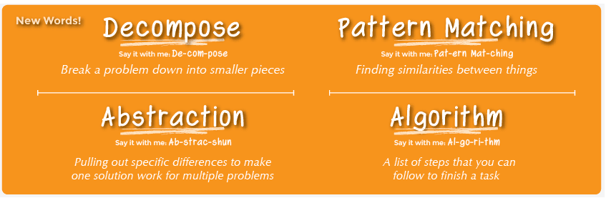

Slide 4
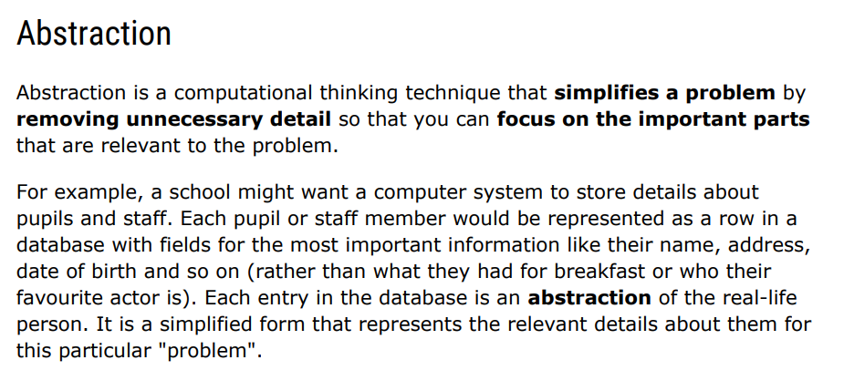

Slide 5
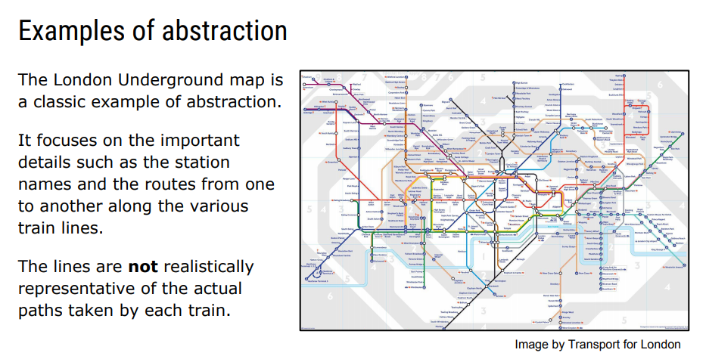

Slide 6
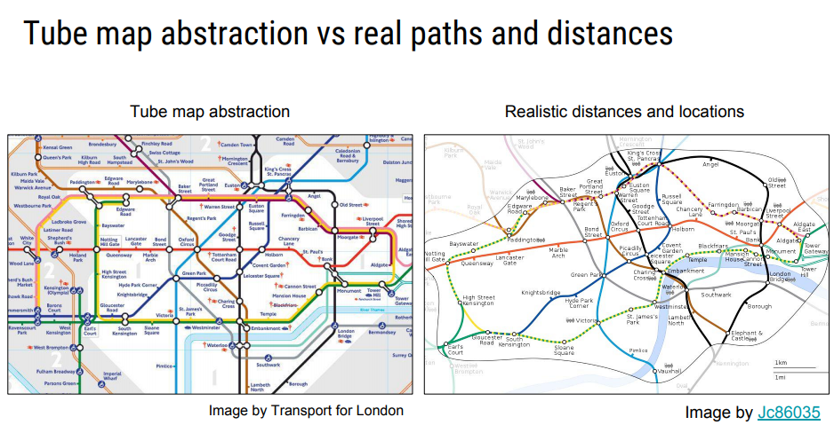

Slide 7
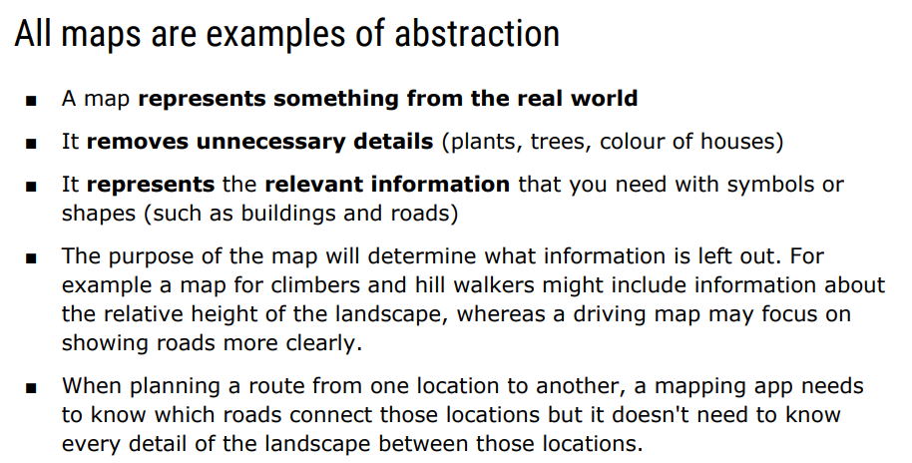

Slide 8
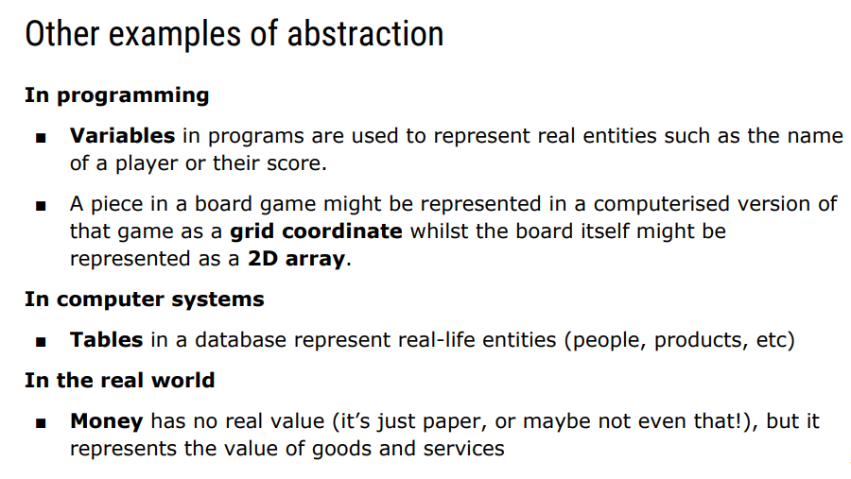

Slide 9
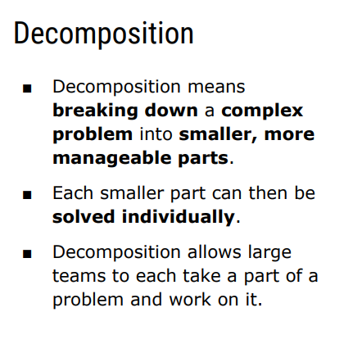

Slide 10
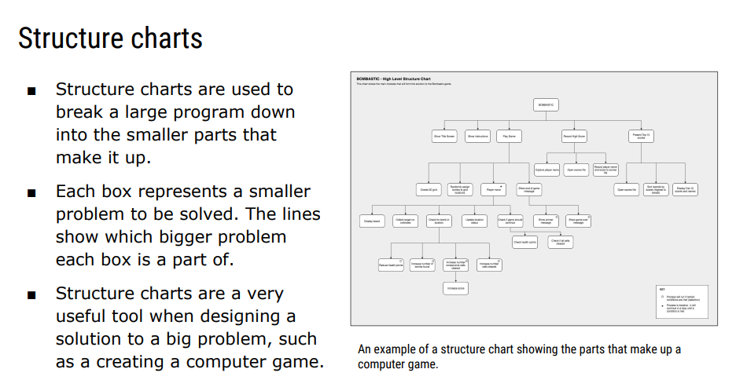

Slide 11
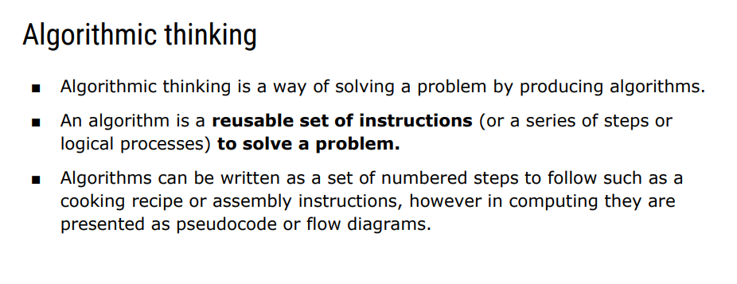

Slide 12
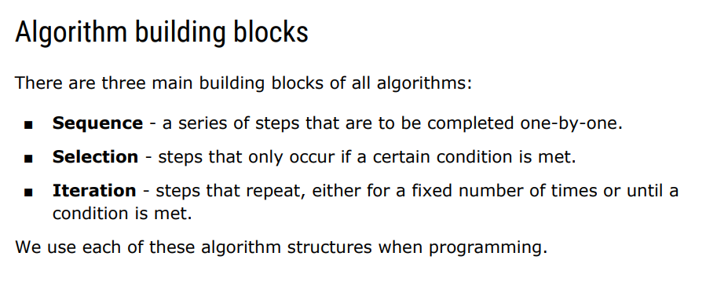

Slide 13
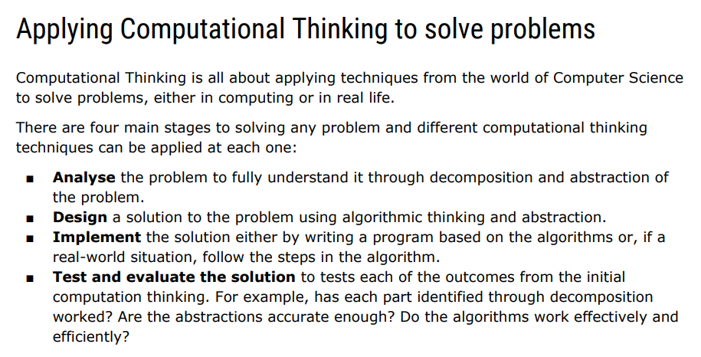

Slide 14
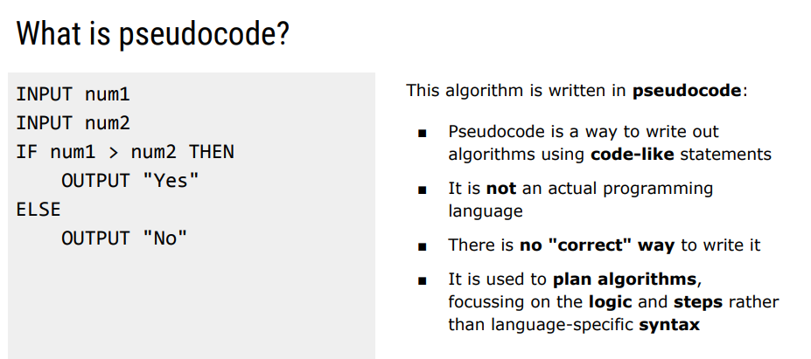
PseudoCode

Slide 15
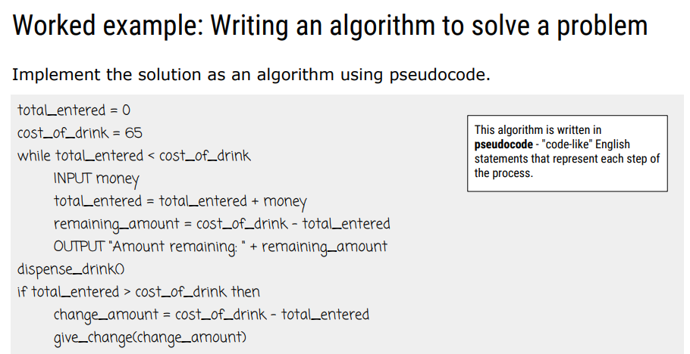

Slide 16
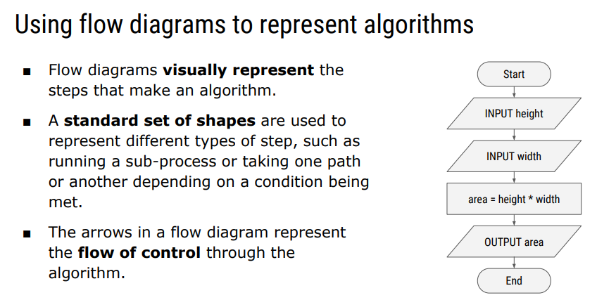

Slide 17
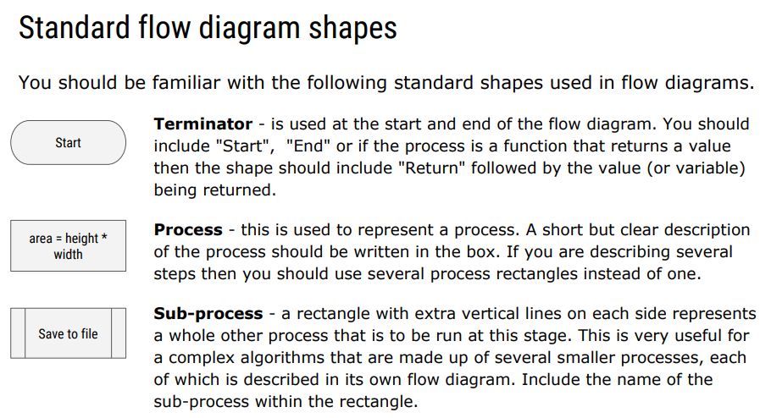

Slide 18
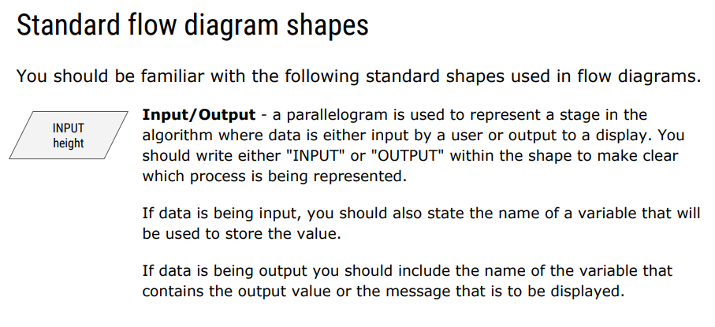

Slide 19
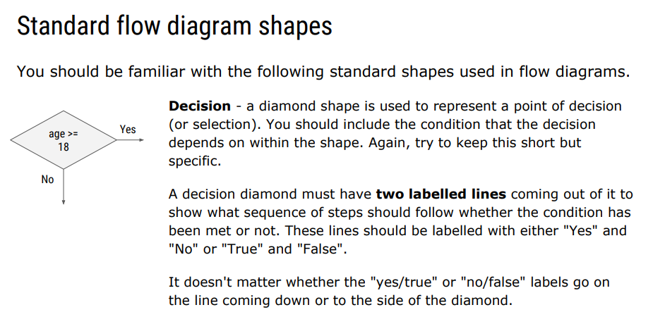

Slide 20
